Slide 1

Does Solar Energy Subsidies Help To Reduce Air Pollution?

Slide 2
Legislation Timeline
H.B. 258
Changed minimum 15-year contract for SREC sale between solar generator and energy supplier to apply to generators greater than 10 kW only
Renewable portfolio standard (RPS)
May 19, 2011
May 22, 2012
2009
April 10, 2012
S.B. 717
Solar thermal systems installed after June 1, 2011 eligible for SREC generation
S.B. 791/H.B. 1187
Accelerated renewable energy goals by 2 years

Slide 3
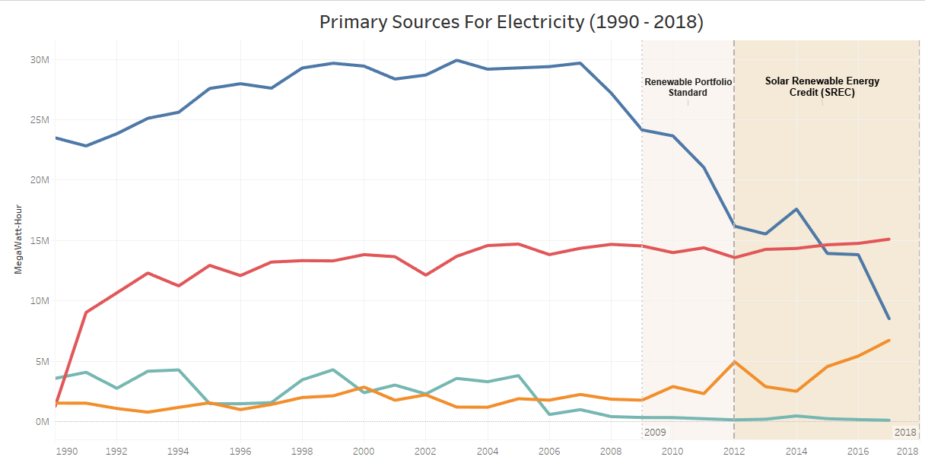

Slide 4
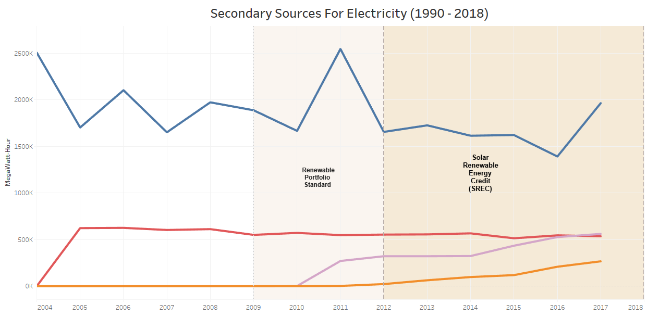

Slide 5
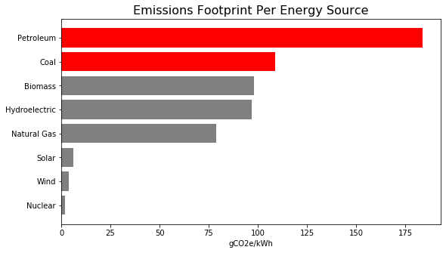

Slide 6
global average target in 2050
15gCO2e/kWh

Slide 7
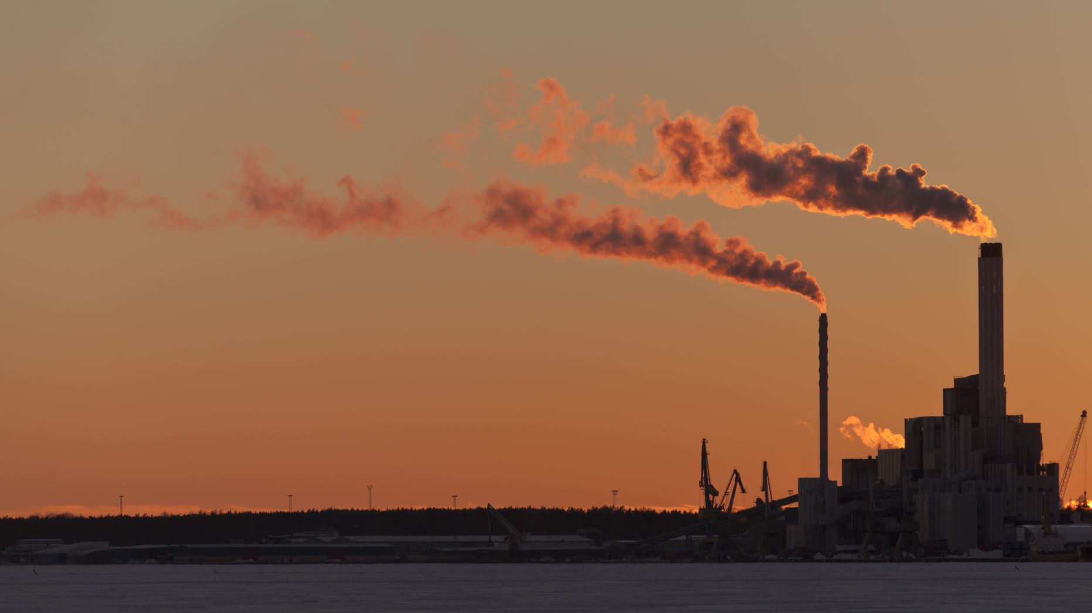
Has CO2 Emissions Decreased?

Slide 8
1990 | 2000 | 2010 | 2020*
4,780,753 | 5,296,486 | 5,773,552 | 6,339,290

Slide 9
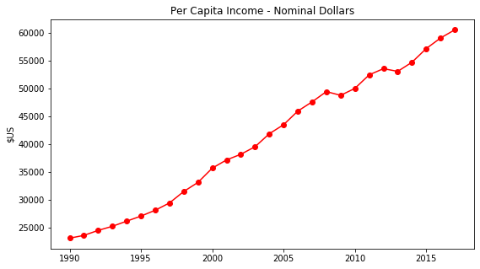

Slide 10
Population Growth + More Income
=
More CO2 Emissions?

Slide 11
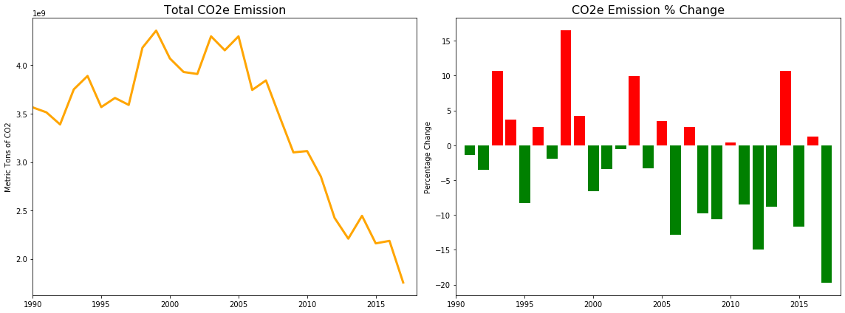

Slide 12
49%

Slide 13
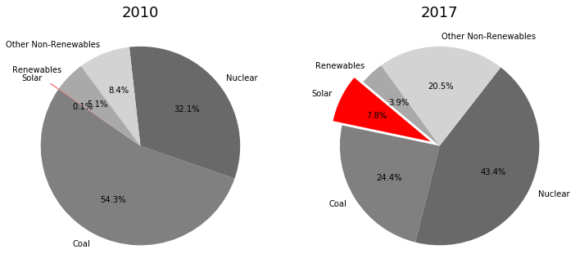

Slide 14
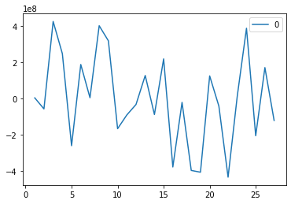
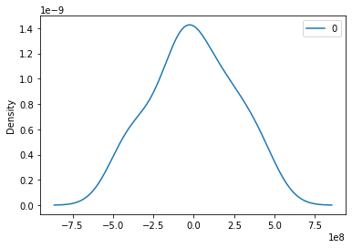
ARIMA Model Results
=================================================
Dep. Variable: D.y No. Observations: 27
Model: ARIMA(5, 1, 0) Log Likelihood -559.937
Method: css-mle S.D. of innovations 240881739.322
Date: Mon, 11 May 2020 AIC 1133.874
Time: 18:00:43 BIC 1142.945
Sample: 1 HQIC 1136.572
=================================================
coef std err z P>|z| [0.025 0.975]
------------------------------------------------------------------------------
const -7.014e+07 6.9e+07 -1.017 0.309 -2.05e+08 6.51e+07
ar.L1.D.y -0.1248 0.174 -0.719 0.472 -0.465 0.216
ar.L2.D.y 0.0735 0.166 0.443 0.657 -0.251 0.398
ar.L3.D.y -0.1354 0.173 -0.781 0.435 -0.475 0.204
ar.L4.D.y 0.1942 0.177 1.097 0.273 -0.153 0.541
ar.L5.D.y 0.3999 0.179 2.237 0.025 0.049 0.750
Roots
================================================= Real Imaginary Modulus Frequency
-----------------------------------------------------------------------------
AR.1 1.1748 -0.0000j 1.1748 -0.0000
AR.2 0.2930 -1.1196j 1.1573 -0.2093
AR.3 0.2930 +1.1196j 1.1573 0.2093
AR.4 -1.1233 -0.5723j 1.2606 -0.4250
AR.5 -1.1233 +0.5723j 1.2606 0.4250
-----------------------------------------------------------------------------
Residuals
Density Distribution

Slide 15
Can Maryland Be a Greenest State?

Slide 16

YES!

